Slide 1
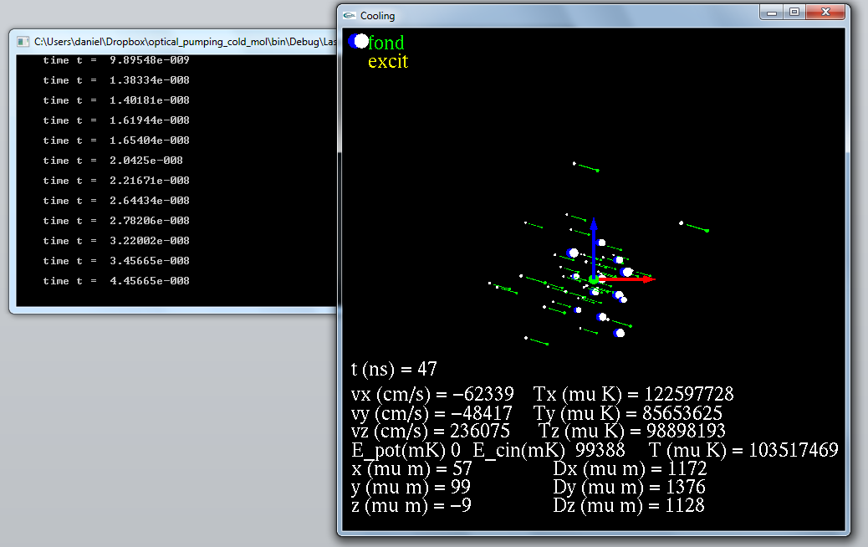
z
J/J_{max}
y
M/J
x
v/v_{max}
Color → electronical state

Slide 2
Evolution in the program
Transitions_initialisation
Initialisation_programme
Main_Laser_Cooling
Define all parametres, tables, … (Read List_Param)
Initialise Levels and Transitions (Read Level and Lines files)
If needed Create new Levels (from Franck-Condon)
LOOP on scanned parameters. Put t = 0
Initialise Molecules (r,v, population), Lasers, Fields
LOOP untill t> t_end
Calcul transitions rates
Predict which reaction and when should occur (t_KMC)
Evolve dynamics (every t_dyn) ← forces + potentials
if t_KMC <t_dyn) evolves also internal states
Each t_dia → output file (sortie donnees)
Each t_out → output graphic (draw)
Transition_rate_calcul
If the molecule has change internal state
Or evergy t_mise_a_jour for all molecules
Caclul for theses molecules the
two level rate for each transition and lasers
Kinetic_Monte_Carlo
KMC algorithm =
Selection of the reaction and time
One_body
Verlet, Boris algorithms to evolve r,v
Shift_molecule
Stark, Zeeman (analytic)
dipolar shift (scan all levels)
Sortie donnees
dipolar shift (scan all levels)
Population in v,J, Level (statistics)
Ex: file_out << Mol[i].get_vel() ;
Affichage_Mol
Draw Molecules
r,v, state +
Statistics T, E_pot, E_kin
Affichage
Draw: axis, laser

Slide 3
Class or structures in the program
datacards
Allow to read laser_param.h
params
List of parameters
Constantes_SI
All constantes
Vecteurs3D
Vectorial calcul
Ex:
Mol[i].get_pos().x();
Fields
Class: with fields parameters
F(r)
Gradient, …
laser
Class: with laser parameters
Spectrum
Rotation of axes
Calcul of local intensity
Algorithmes
Basic functions
binary search
Wait
…
Atome
Class (« external state »)
r,v,a, m, q
Molecule
= Atome + Internal state
Internal_state
Class (« internal state »)
Level :
Electonic (v,J,..)
Energy (0 field and actual)
Transitions: point towards all allowed Level
Stat_Molecules
For specific Levels
Stat on r,v, Energy
Ex:
stat_Mol[level_i].Temp_3D_50 ;

Slide 4
Lab axis
(Oxyz)
Laser axis
(0x’y’z’)
z
e’_{z}
e’_{y}
Polar (spherical coodinates)
For the helicity (polarization)
Basis:
σ⁺ polarization : e’₊₁=(-e’_{x} - i e’_{y})/sqrt(2)
σ⁺ polarization : e’₋₁ =( e’_{x} - i e’_{y})/sqrt(2)
π polarization : e’₀= e’_{z}
(π polarization is not used because the
polarization is defined in the laser axis)
θ
ψ
Polarization
vector
k
e’_{x}
Field
(B,E)
Quantization field axis
(0XYZ)
y
φ
x
To define a laser axis we give the direction of the k vector (in x,y,z, the lab coordinate). Thus the waists axis x’(e’_{x}=e_{θ}) and y’ (e’_{y}=e_{φ}) are defined.
For the polarization we add a rotation angle ψ along the z (that is k) axis.
Example: linear polarization at 45° is: ψ = 45; e_{X}=(e’₋₁-e’₊₁)/sqrt(2).
So in list_param Pol_circulaire_left_sp -0.7071; Pol_circulaire_right_sm[0] 0.7071; polar_angle_degree 45
Adiabatic following of the states makes the quantization frame given in the same way than the laser frame.

Slide 5
Molecule = r,v, + pointer to the level she occupies
Levels (in 0 field)
Lines = allowed transitions
(= Level i pointer to Level j)
External Field = local quantification axis
B,v’’,J’’
A,v’,J’
X,v,J
Linear and quadratic
Stark, Zeeman
Effect

Slide 6

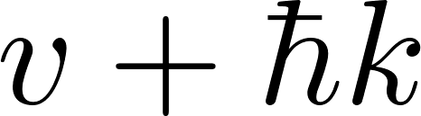
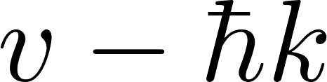
Assumptions for diagonalization: energy ordering
The calculated energy level for absorption is done properly (with recoil)
For spontaneous emission (k not known) we assume no change in lower states
Energy level order
Level[i] for i=
5
5
n=2,
Possible
crossings
4
4
Spontaneous emission
Diagonalization done at
Absorption
Diagonalization is done at
3
3
n=1,
no level crossings
2
2
1
v
1
0
0
v

Slide 7

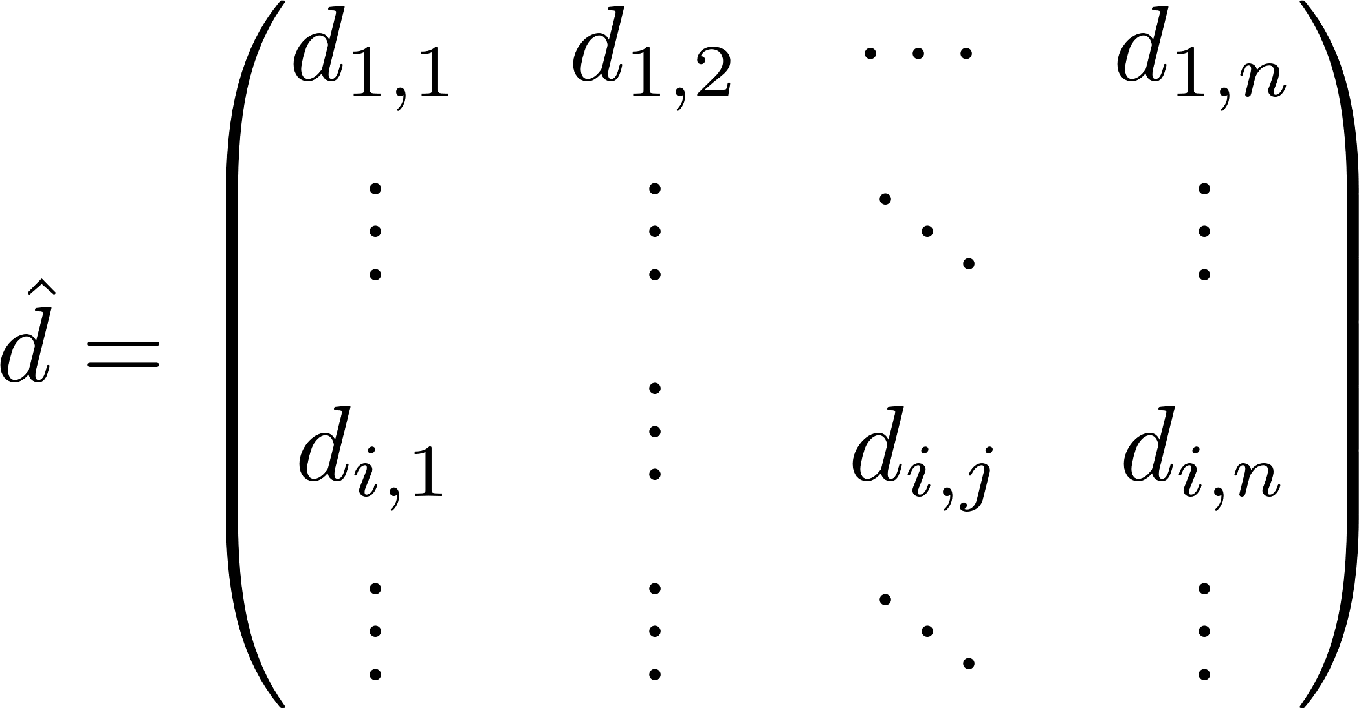
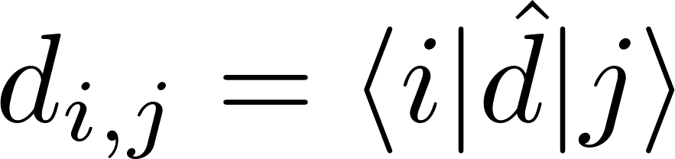
However E’ is not a real vector.
So not very good
V = -d.E
In rotating wave approximation if |1> BELOW |2> we find
So absorption j (=1) →i (=2) is due to -d.E’. Amplitude
So stimulated emission (or spontaneous emission) i (=2) →j (=1) due to ) due to -d.E’^dag
Amplitude
So dipoles are same (conjugated) for absortion or emission

Slide 8
Reaction_rate coded as {n_mol; n_laser; quant_axis; pol_vector; k_eff_laser; final_internal_state}
calcul_rates_molecules
copie_rates_molecules
rates_molecule_spon
→ rate Γ
Loop molecules + levels below
{ num_mol, -1, axe_quant, dq_ij , k_spon, Level[j]}
reaction =
{ n, -1, axe_quant, axe_quant, k_spon=(k,0,0), I_out};
Loop laser + molecules
rates_molecule
rates_single_molecule_laser_level
rate_excitation
Loop
transitions
Rates for intererence laser (not done if diagonalization)
for Different laser,
ionization, BBR)
evolve_step
{ n_mol, n_las, k, k, k, Internal_state_out}
Sontaneous, stimulated, absorption, ionisation …
do_reaction
get_unit_vector_spontaneous_emission
k_photon_transfer_to_particle
such that r(θ, φ) has the probability f(r)= (3/8π)[1-|r.e_p|^2]

Slide 9
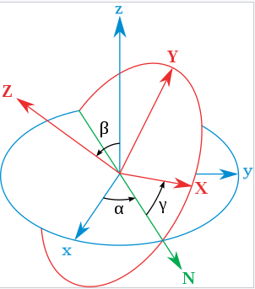
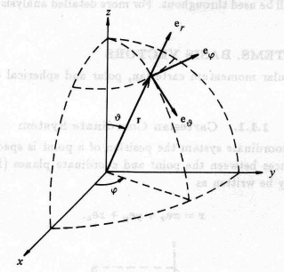
Polar (spherical coodinates)
For the helicity (polarization)
basis
Laser axis
k
e_{Z}
e_{Y}
e_{X}
Lab axis
ψ
Polarization
vector
Euler angle (in Z X Z rotation order)
α=φ+π/2
β=θ
γ=ψ−π/2
Correspond to Euler rotations but for
Z Y Z (φ, θ,ψ) order
To define a laser axis we give the direction of the k vector (in x,y,z, the lab coordinate). Thus (ψ=0) the waists axis X and Y are defined.
For the polarization we add a rotation angle ψ along the Z (k) axis. Example: linear polarization at 45° is: ψ = 45; e_{X}=(e₋₁-e₊₁)/sqrt(2). So in list_param Pol_circulaire_left_sp -0.7071; Pol_circulaire_right_sm[0] 0.7071; angle_psi_degree 45

Slide 10
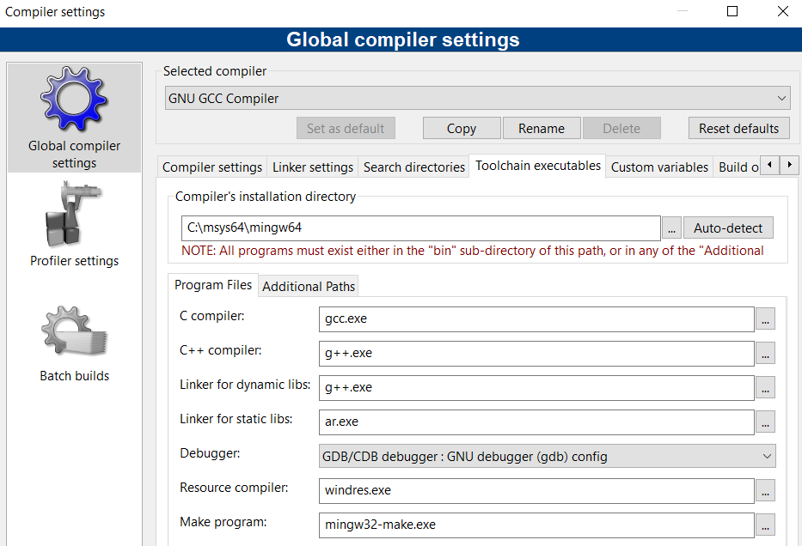
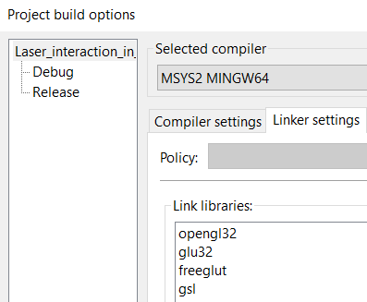
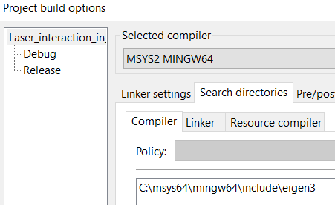
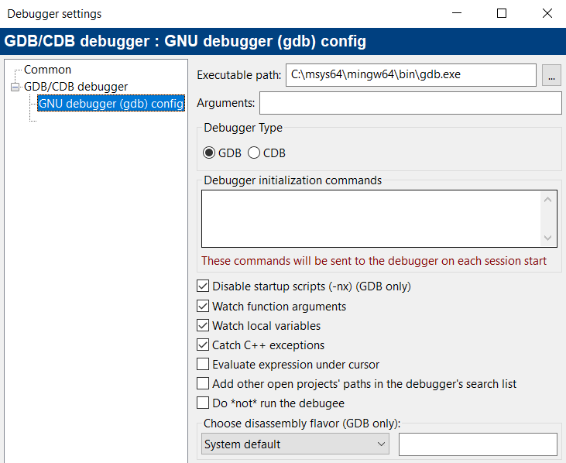
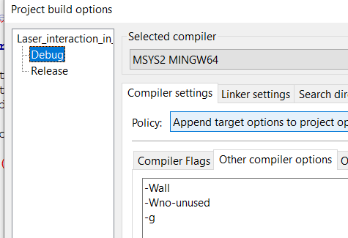
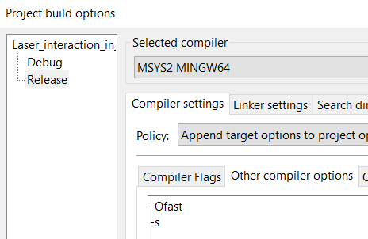

Slide 11
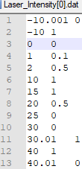
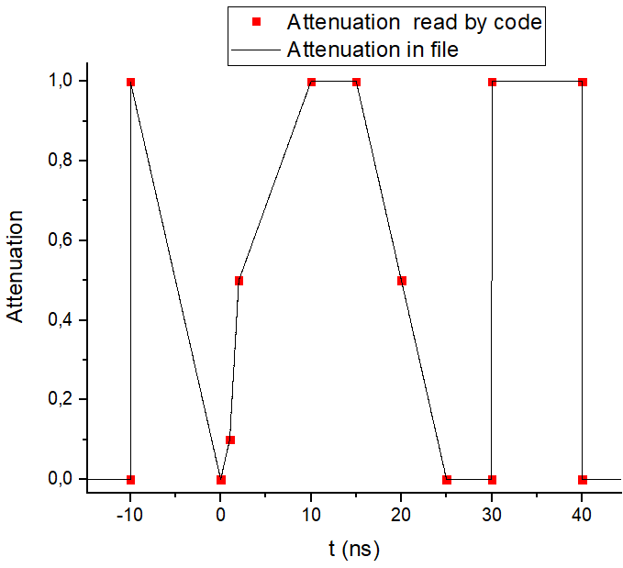
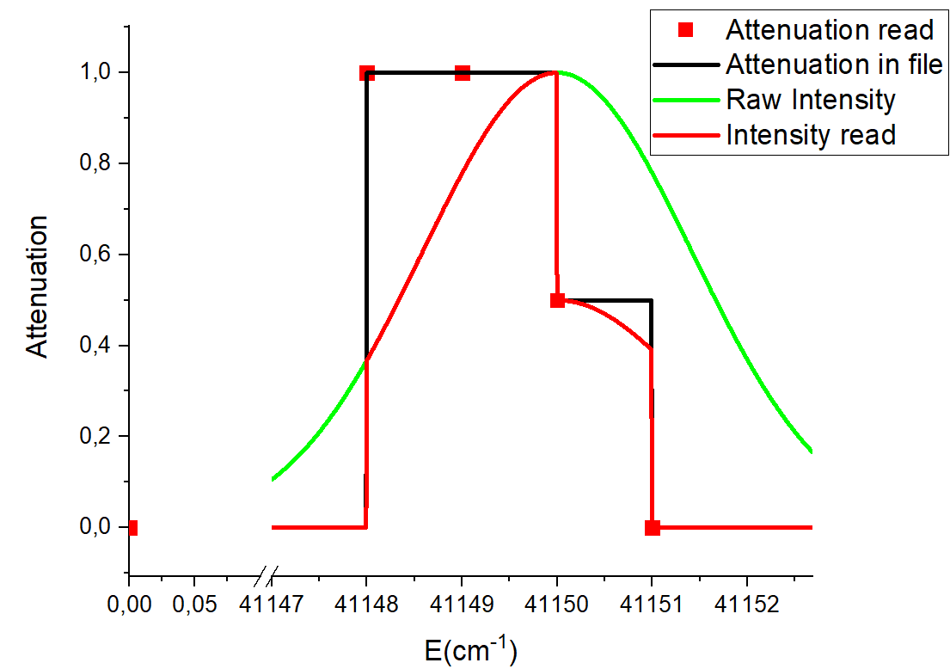
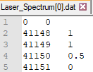
Laser Intensity (versus time)
Laser Spectra
File by default (this is the value if no file)
0 1

